Slide 1
Resume Job Matching
Group 12

Slide 2
Problem Statement and Importance
All of us have experience the wrath of rejects within a short span of time post applying to our dream jobs.
The reason is pretty simple companies use tools such as Application Tracking Systems to filter out the Resume.
Why do they use it?
Companies advertising open positions often have hundreds, if not thousands applicants often too much for any one person — or even a small group of HR staff members — to deal with on their own.
That’s how these resume robot programs came into existence for the most part — as an aid to overwhelmed hiring managers.

Slide 3
Problem Statement and Importance
Is it really a big problem?
Yes, Over 90% companies use them
Risk of using such bots from an employer stand point of view?
Many highly-qualified candidates are rejected by ATS because they fail to write their resume for the resume screening software.
The risk of loosing out qualified people is worth taking considering the amount of time and money they save using this screening robots.

Slide 4
How does it work?
First, the software removes all formatting from the resume
Next, it sorts the content of your resume into individual categories
Employers skill and the resume are matched
Resumes with the highest scores relevant to the employer’s specified keywords and phrases combined with your years of experience are picked.
In the end, the software simply scores the resume

Slide 5
Steps in trying to Converge towards a Solution
Get some Job descriptions
Get a Resume
Do something amazing to solve the problem

Slide 6
Step 1 Get some Job descriptions
Glassdoor public API – Failed
Web Scrapping using Beautiful Soap – Failed
Selenium to mimic human like behavior – Successful

Slide 7
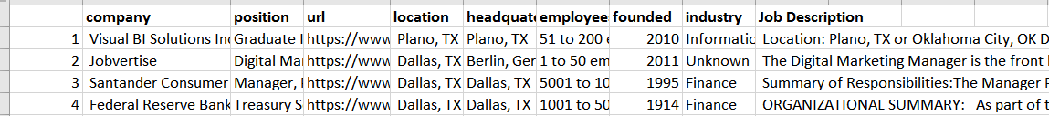
Step 1 Get some Job descriptions
Glass door URL was generated based on the user entered Search keyword and the location ID
Mozilla web driver was used to initiate a URL launch
All the job were fetched, navigating to all pages of search results
Required information fetched into a Pandas Data Frame

Slide 8
Step 2 Get a Resume
Generally a resume is in .doc or .pdf formats
PDFMiner is a PDF parsar to get the PDF in text and various other forms

Slide 9
Step 3 Defeating ATS
Counting words and matching will not be the only solution to this problem
Attempted
TF-IDF, CountVectorizor
Solution
Deep learning through word2vec/Doc2vec

Slide 10
Step 3 Defeating ATS
Training required with a huge data set to learn specifically to this domain.
Doc2Vec – Training with Company name tags
Do2Vec – Training with ‘Job’ as a Tag
Google Word2Vec – Alternate but less efficient solution

Slide 11
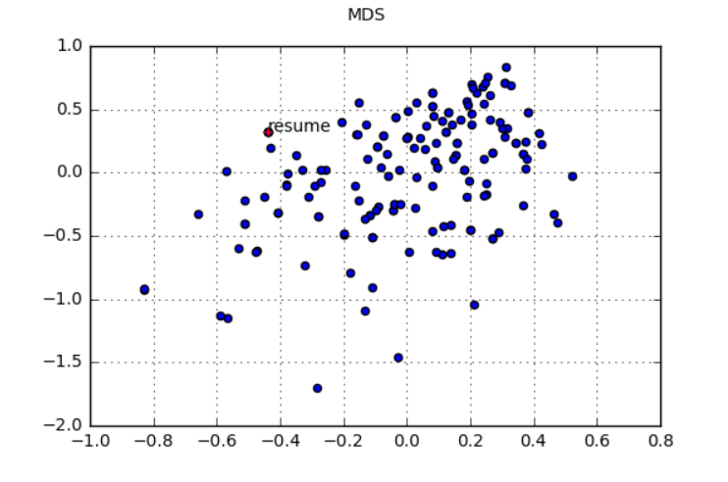
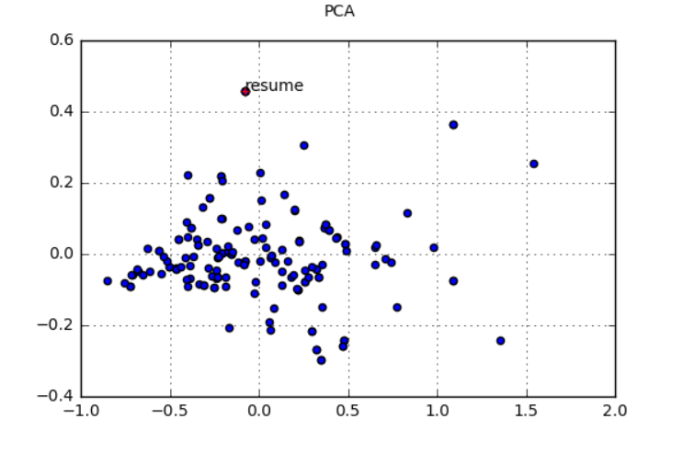
Step 3 Defeating ATS – Single Vector
Each Job Description is represented in the form a list of words vectors in a 300 dimensional vector space
We need each document as a single vector representation to find the distances
Initial solution was to take the average of all the dimensions of each word to get a single vector representation of a Job Description

Slide 12
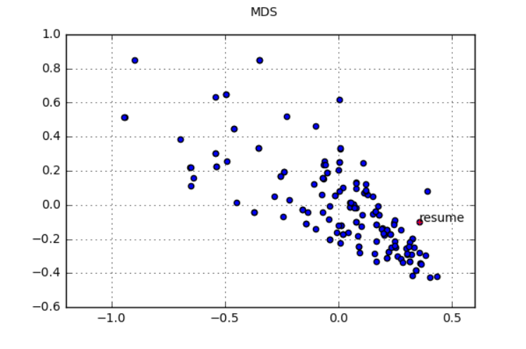
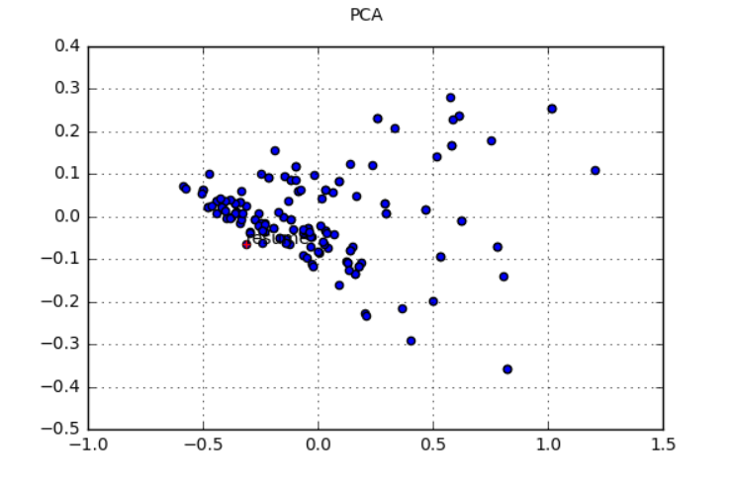
Step 3 Defeating ATS – TFIDF Vector
Better Solution – TF-IDF Scores
Each word vector is multiplied to its TFIDF score to understand the importance of the word
We don’t want Key skills such as ‘Python’ to have low weights

Slide 13
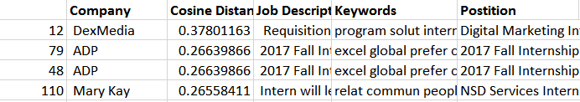
Step 3 Defeating ATS – Cosine Similarities
To get a judgement of distances for each Job Description cosine distances from the resume was calculate
The results were stored in a Dataframe

Slide 14
Validations and Improvements
Positive and Negative cases to find the threshold similarities value
Train our very own Word2Vec model to get domain specific results
Identify the key skills and give distinguishing factor
Resume and Job Description parsing using Regex to remove unwanted information
Get input in a more structured form rather than raw data

Slide 15
Ways to Improve Match
Top Modelling – Limited Scope
Not all Job Description have the same topic and requirements
Similar Jobs can be clustered and Topics extracted
Keyword Method of Genism Module – Resultant words are too generic
Find words close to the Job description vector and in-corporate the same in the resume

Slide 16
Thank you

